Slide 1
Role of DNA Methylation in Physiological Development of Neocortical Inhibitory Circuitry
Alexander Flyax
Neliano lab meeting 13 Feb 2014

Slide 2
Background
DNMT project
NRG-1 project (preliminary data)
Mecp2 project
Summary

Slide 3
“The functional superiority of the human brain is intimately bound up with the prodigious abundance and unusual wealth of forms of the so-called neurons with short axon.”
— Santiago Ramón y Cajal, 1923

Slide 4
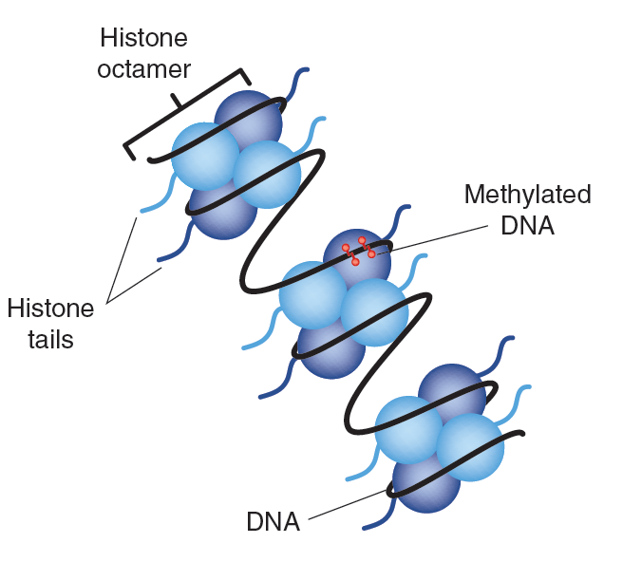
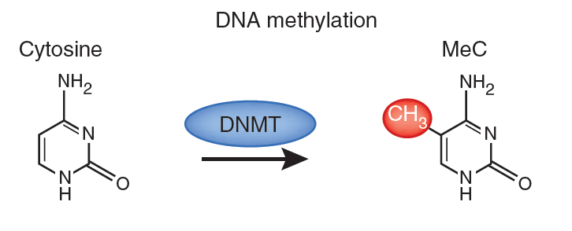
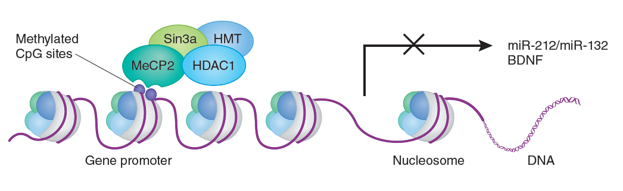
DNA Methylation
(Sweatt et al., 2013)

Slide 5
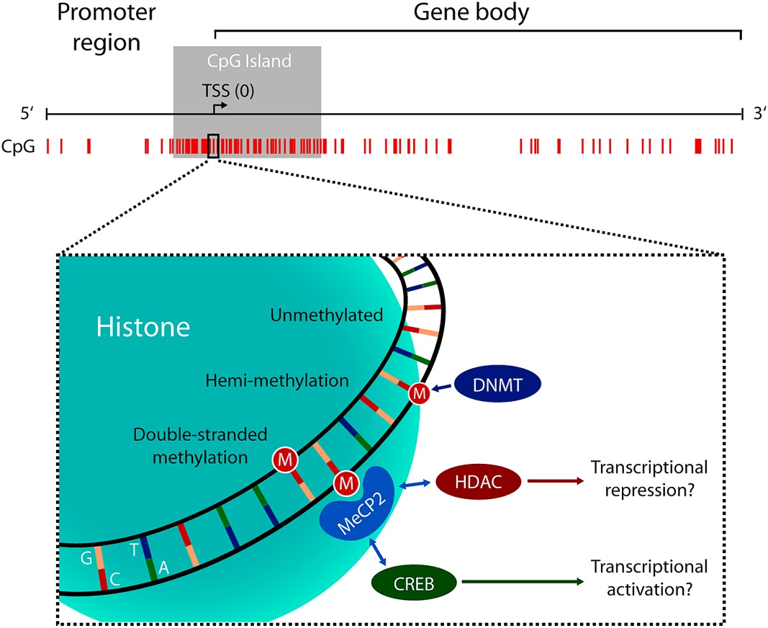
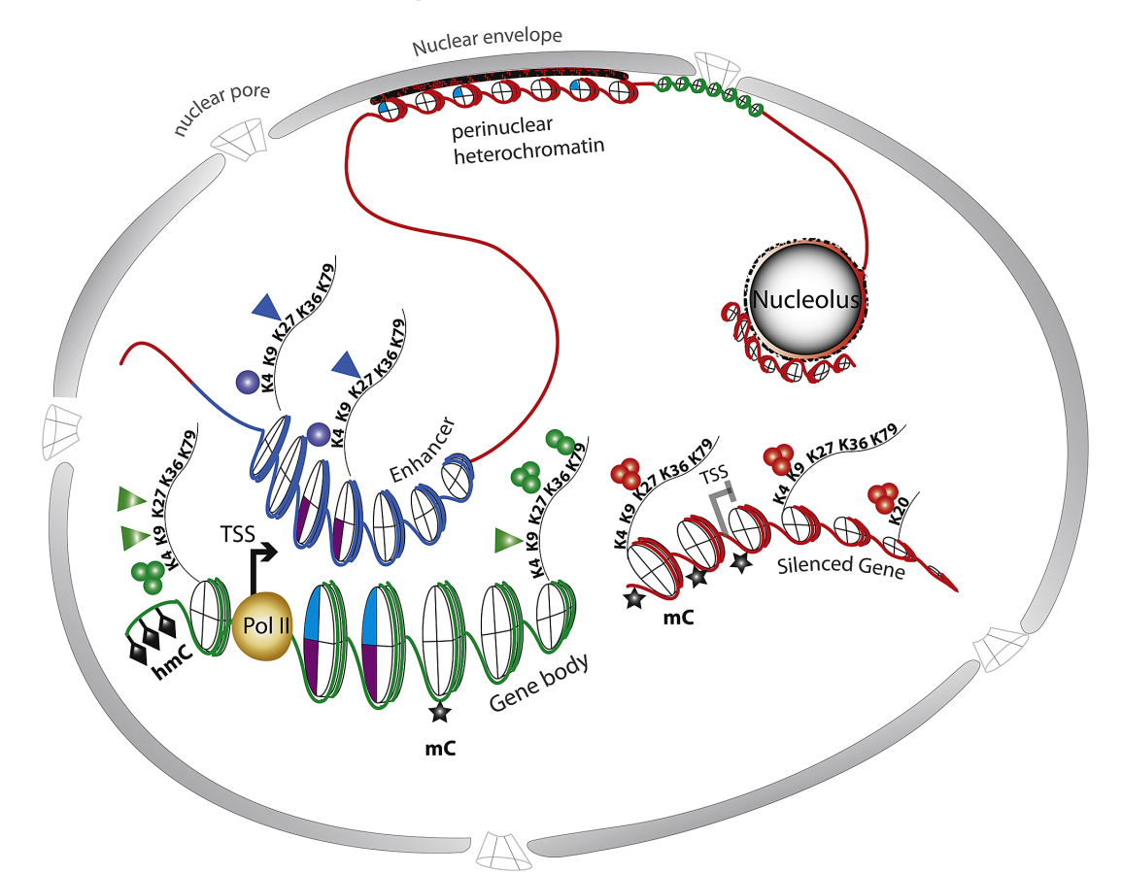
(Sweatt et al., 2013)

Slide 6
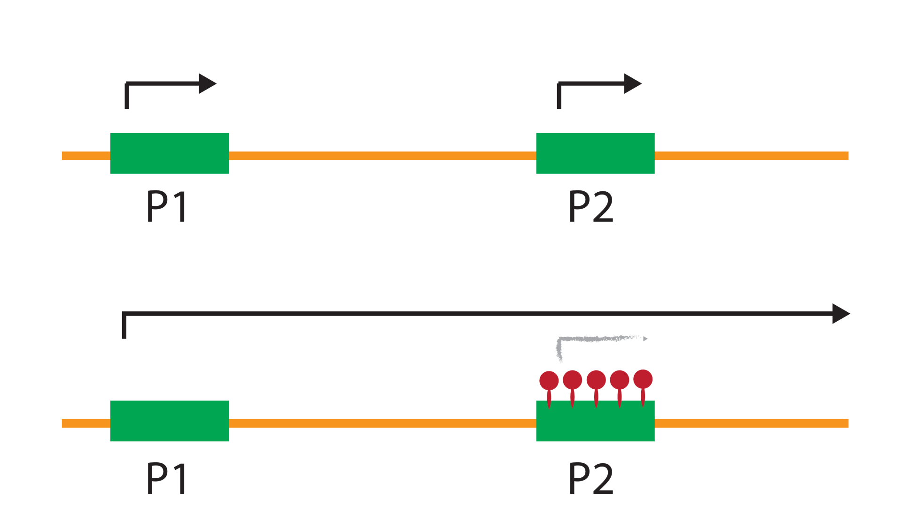

Slide 8
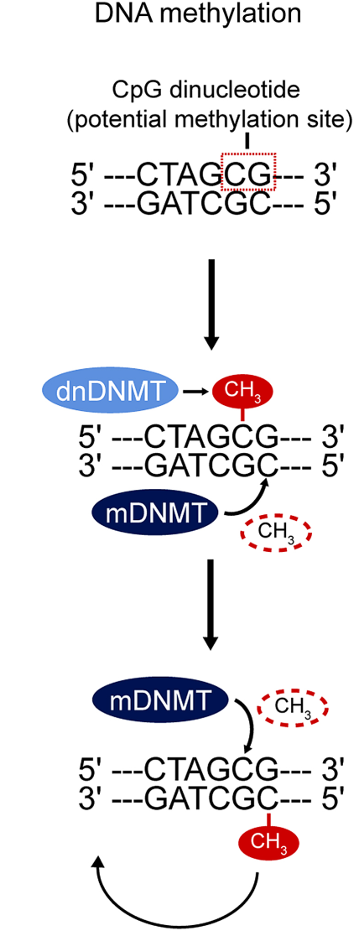
DNA methyltransferases (DNMTs):
Maintenance:
— DNMT 1*
De-novo:
— DNMT 3a*
— DNMT 3b
* present in adult brain

Slide 9
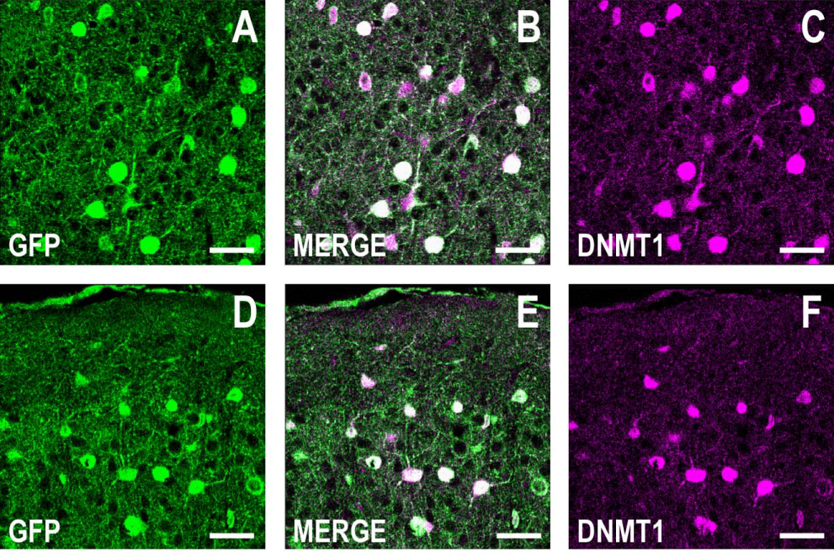
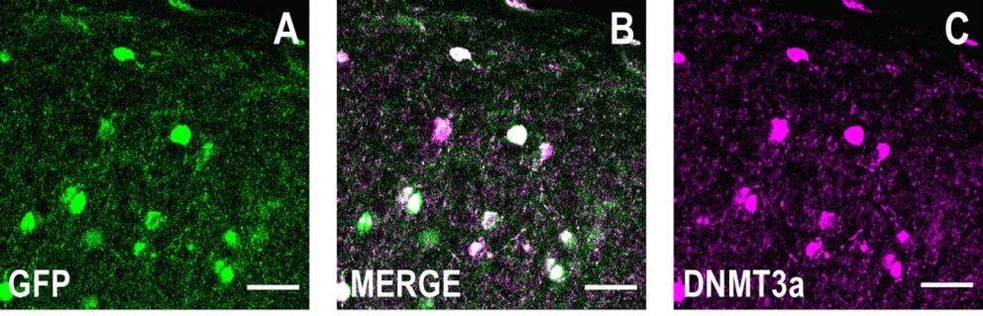
(GAD-GFP)
(Kadriu et al., 2011)

Slide 10
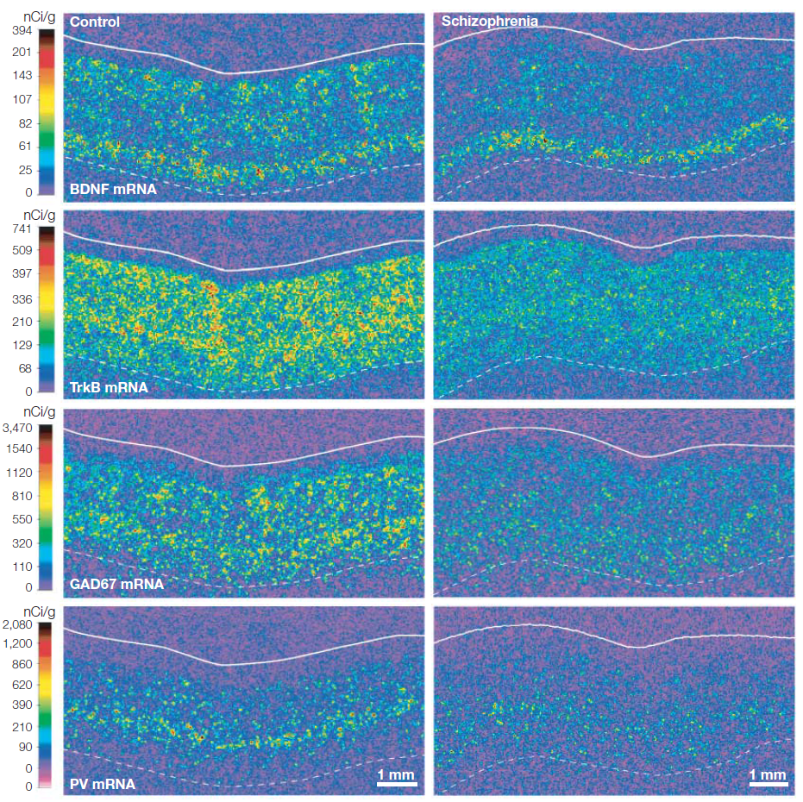
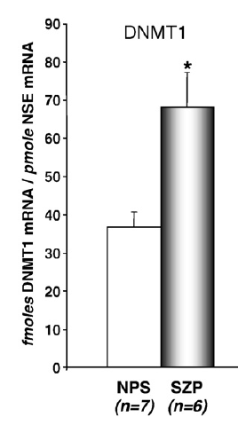
(Hashimoto et al., 2008)

Slide 11
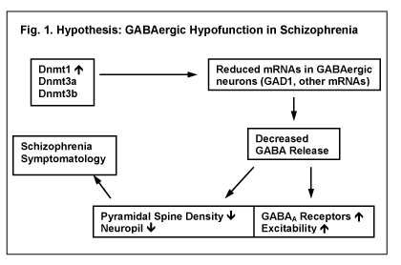
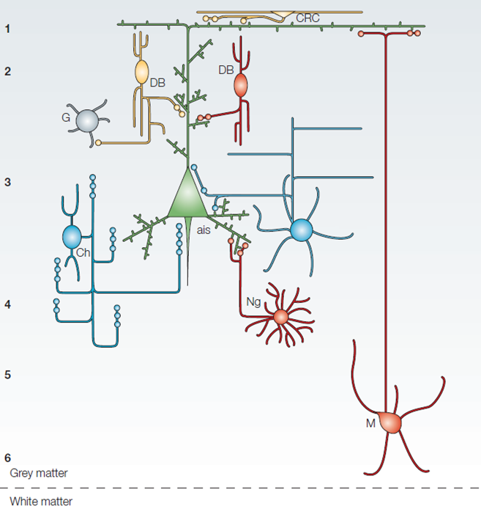
(Lewis et al., 2005)

Slide 12
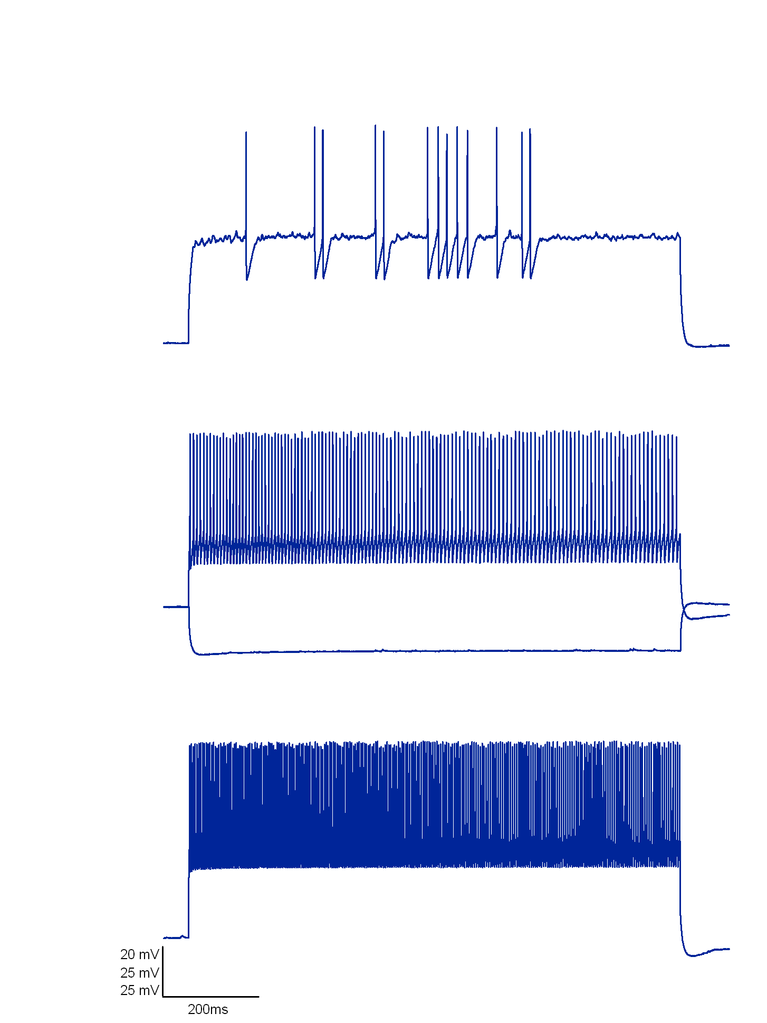
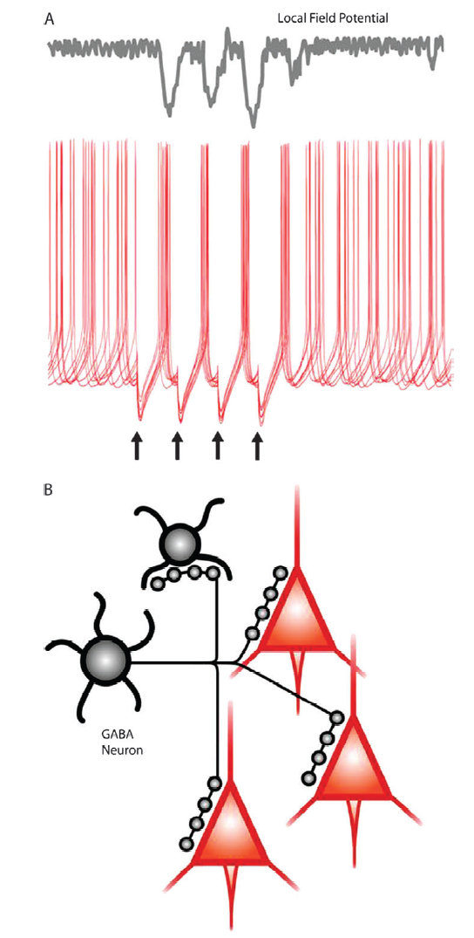
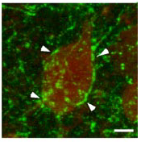
parvalbumin-positive fast-spiking interneurons
PV-FS INs
(Chattopadhyaya et al., 2004)
(Lewis et al., 2005)

Slide 13
Fast-spiking cells are coincidence detectors/fast integrators:
smooth dendrites
low R_{in} and τ
fast AMPA conductances
high dendritic K⁺ channel expression
depressing excitatory synapses
minimize temporal summation, maximize synchrony detection
high EPSP/AP coupling

Slide 14
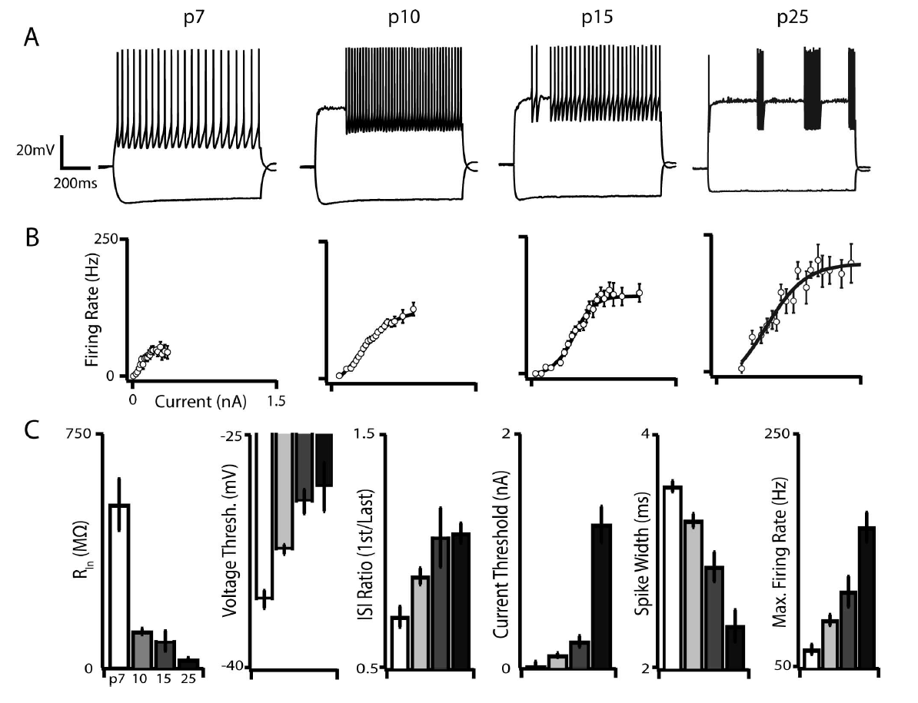
FS cells: intrinsic properties
(Okaty et al., 2008)

Slide 15
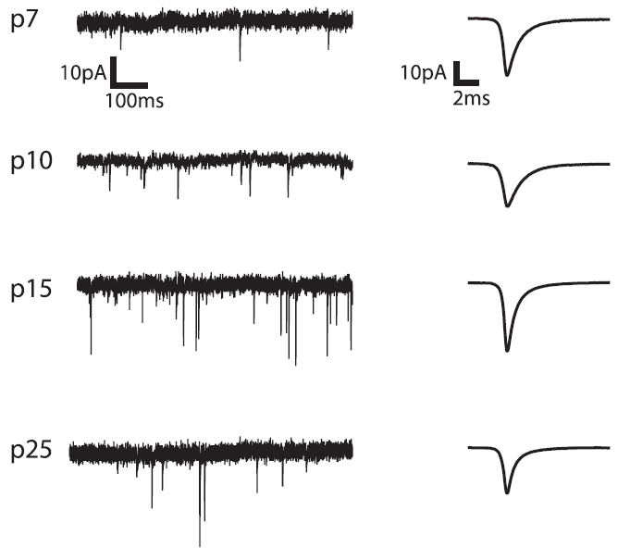
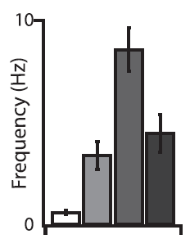

excitatory input: mEPSCs
reduction in presynaptic input/post-synaptic sensitivity correlates with coincidence detection role

Slide 16
Background
DNMT project
Mecp2 project
NRG-1 project
Summary

Slide 17
FS cells: intrinsic properties
(Okaty et al., 2008)

Slide 18
role of DNA methyltransferases?

Slide 19
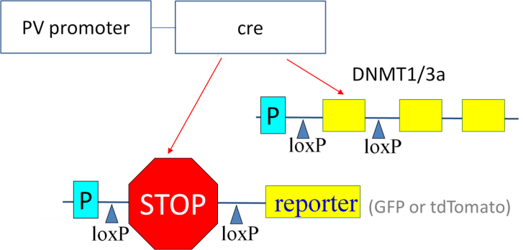
alleles
PV^{CRE/CRE} + reporter^{lsl/wt} + …
^{cKOs:}
DNMT1^{lox/lox} DNMT3a^{lox/lox (or both)} ^{controls and HETs:}
DNMT^{wt/wt} (WT) DNMT^{lox/wt} (HET) DNMT1^{lox/wt} + DNMT3a^{lox/wt} (2x-HET)

Slide 20
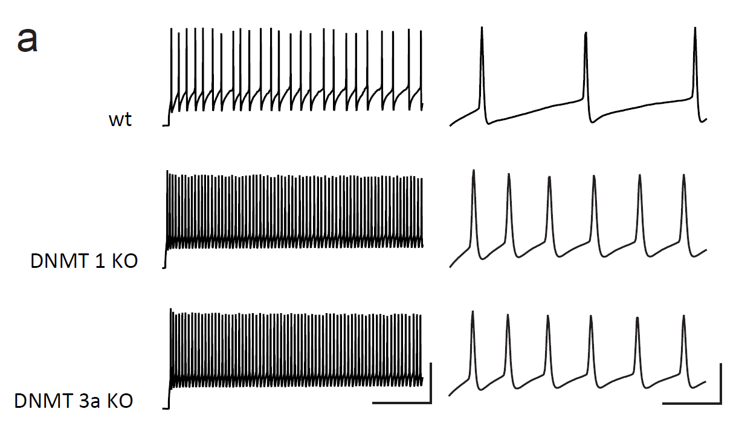
intrinsic properties

Slide 21
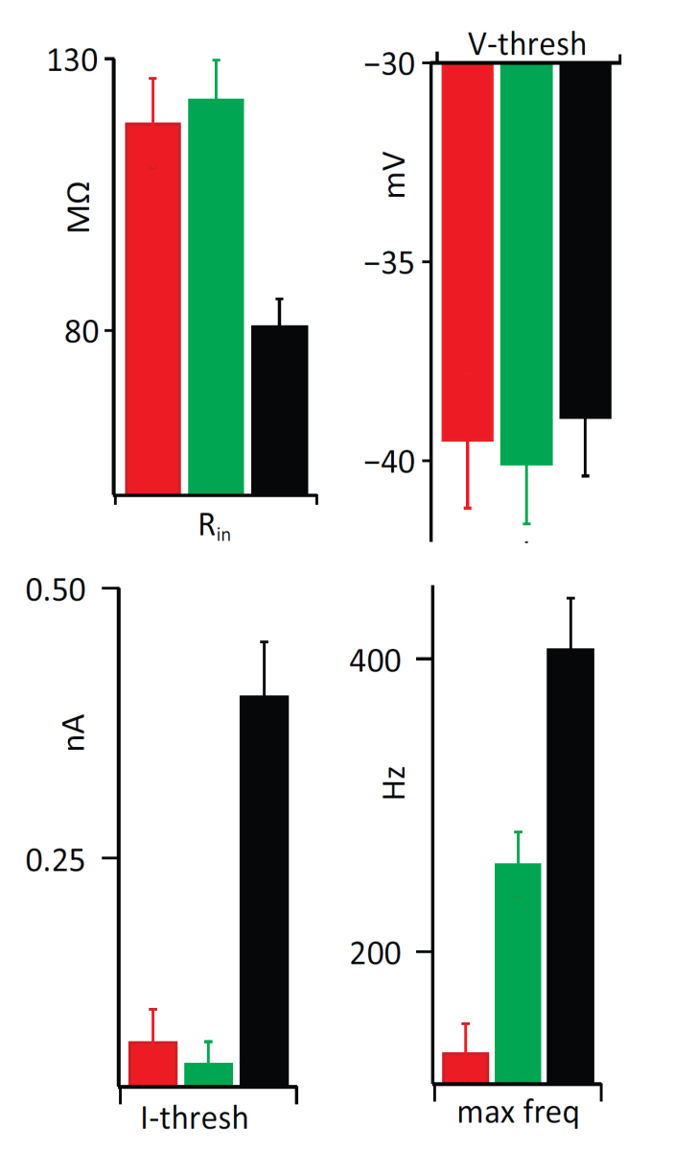
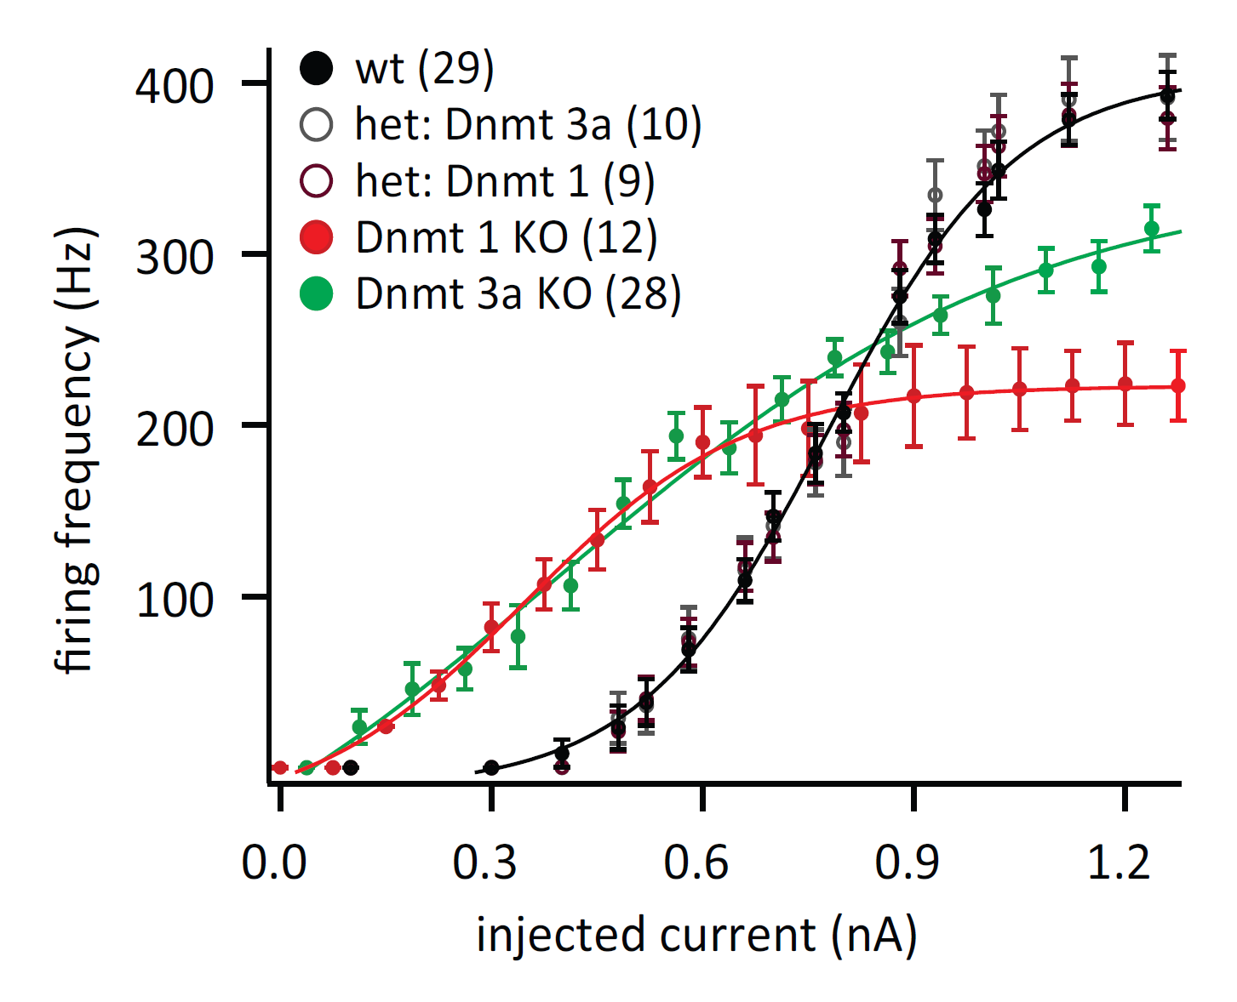
intrinsic properties: P30, SI (BF), layer 5

Slide 22
(Okaty et al., 2008)

Slide 23
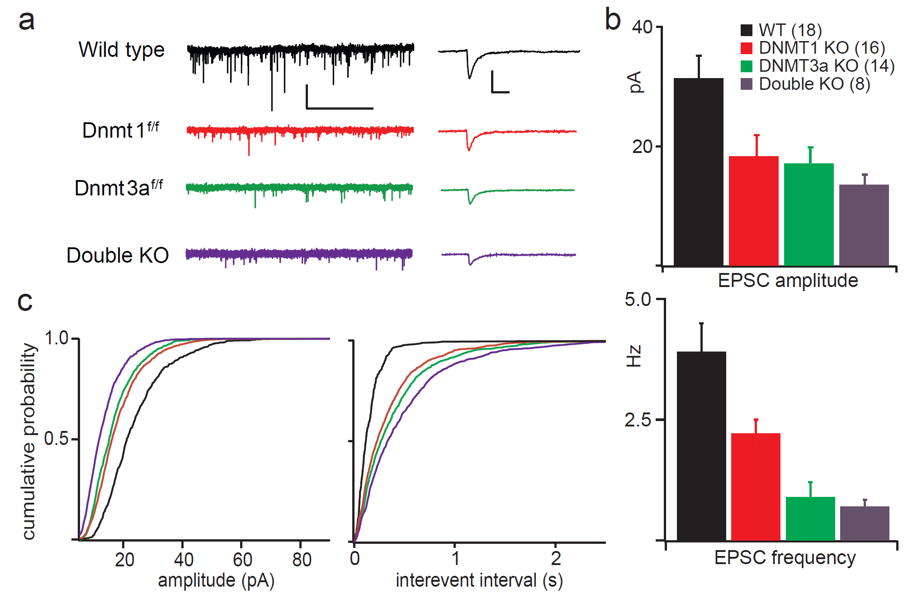
excitatory input: mEPSCs (P30)

Slide 24
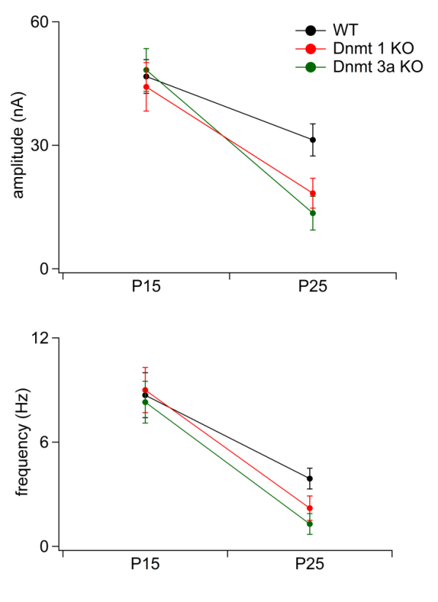
excitatory input: mEPSCs
P15
P30
P15
P30

Slide 25
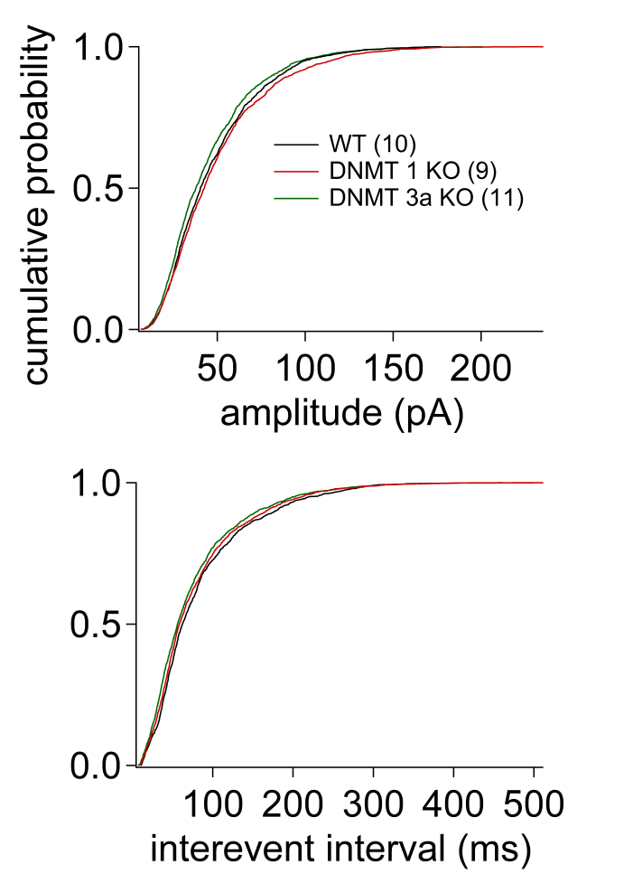
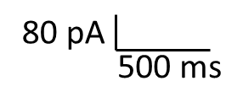
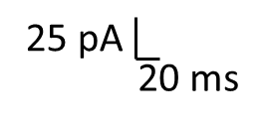
inhibitory input
WT
1^{f/f}
3a^{f/f}

Slide 26
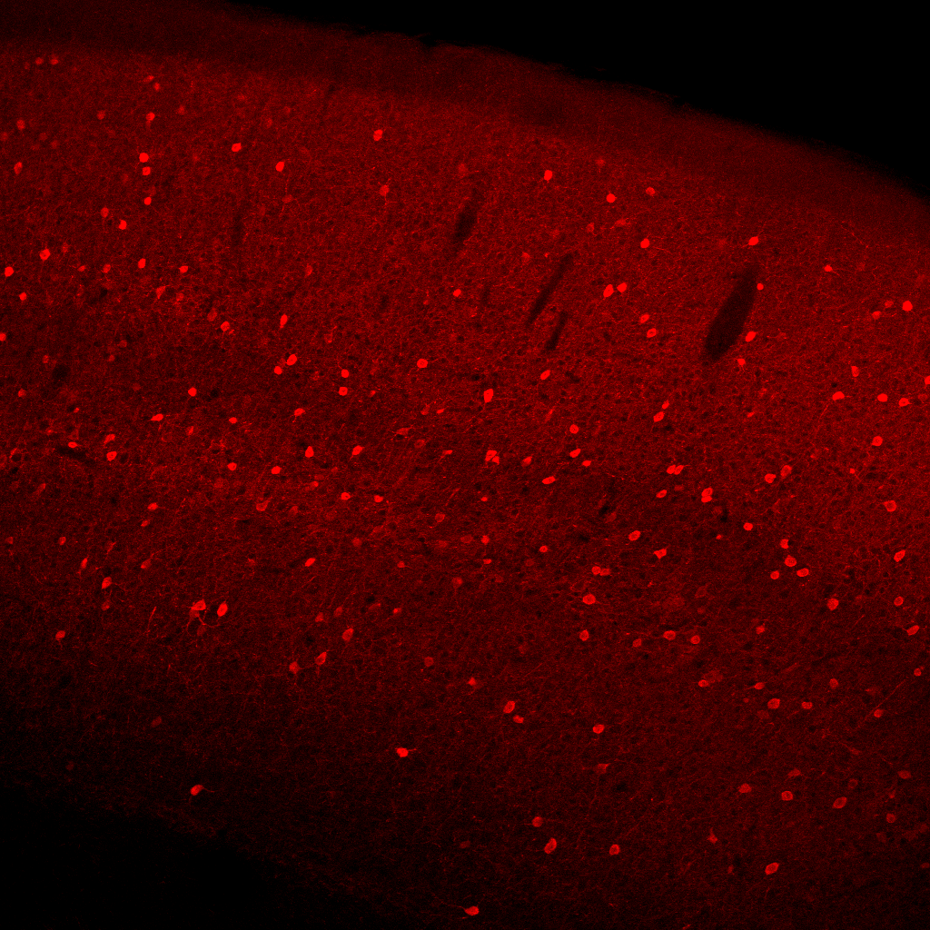
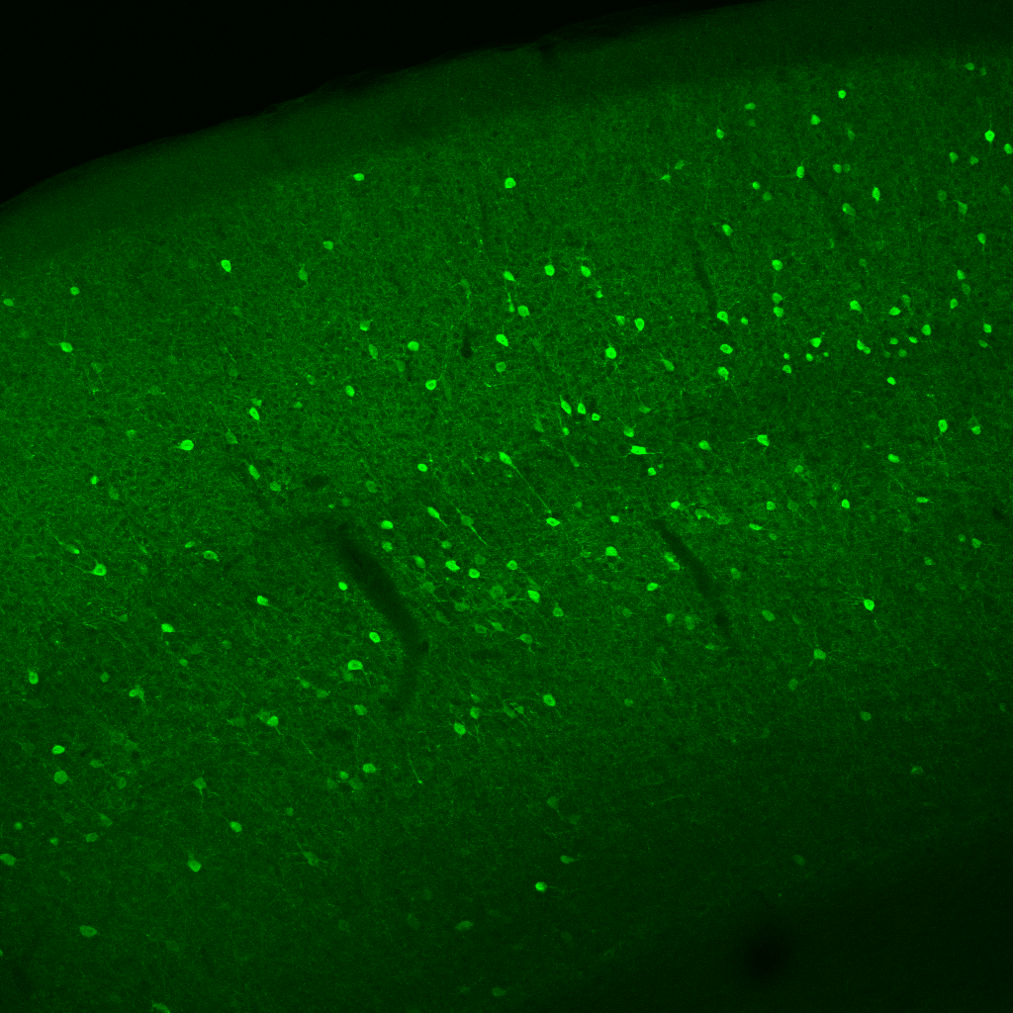
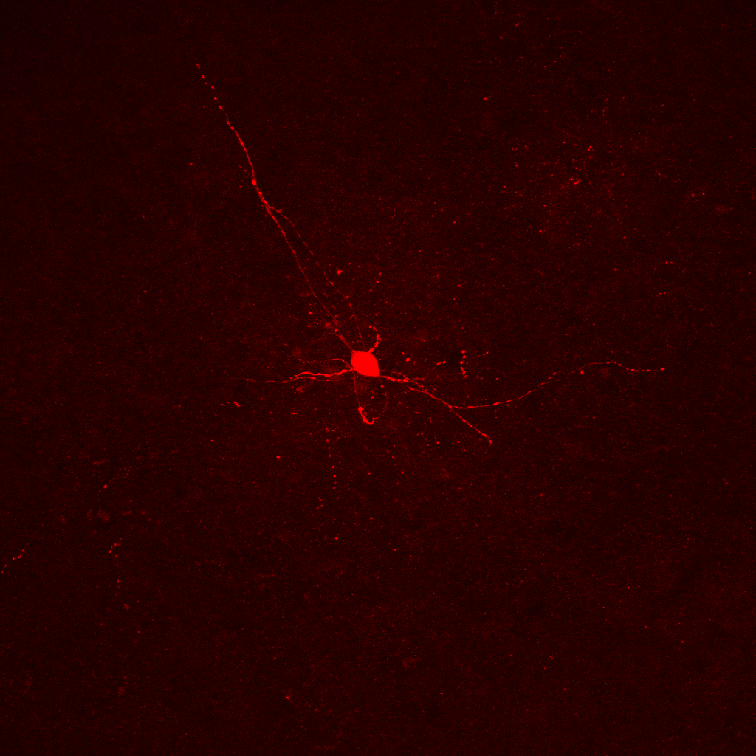
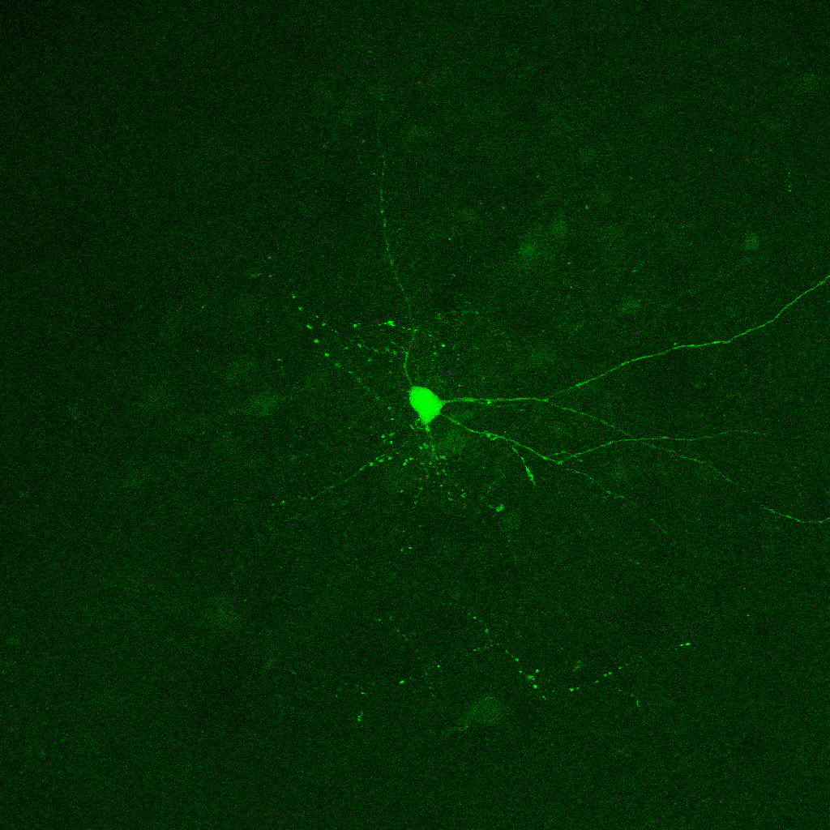
histology
^{WT}
^{Dnmt 3a} ^{cKO}

Slide 27
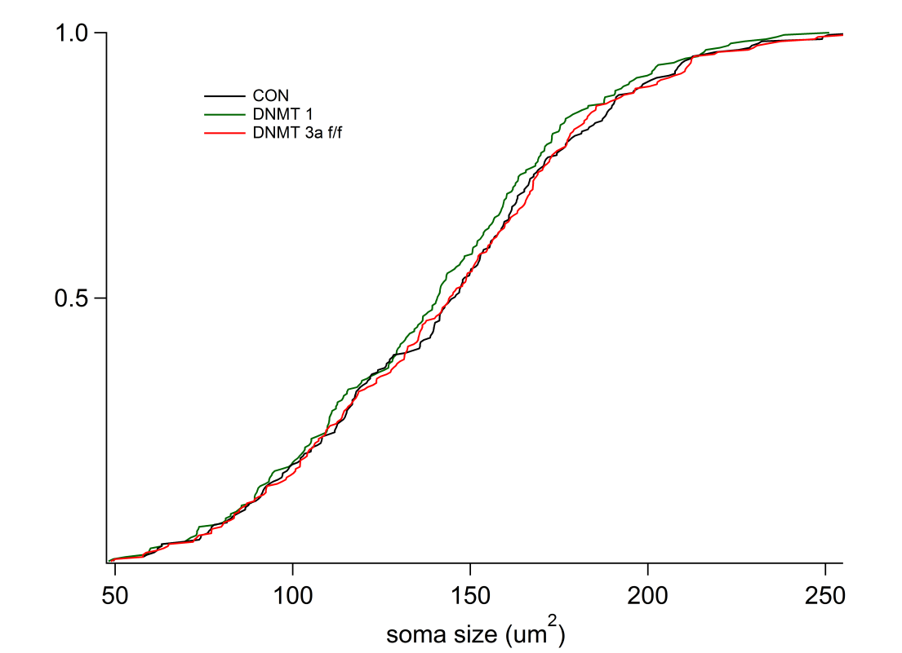
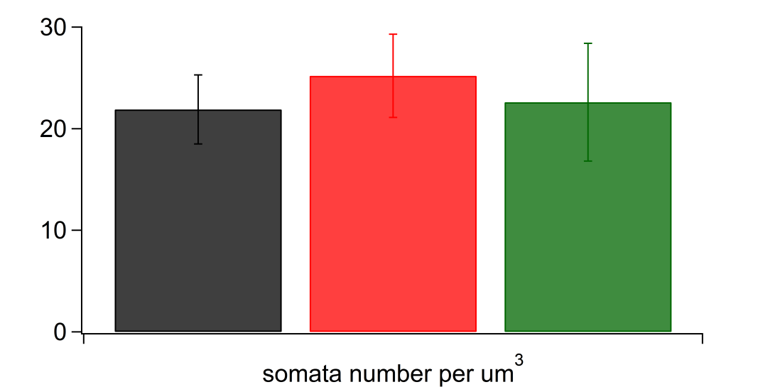

Slide 28
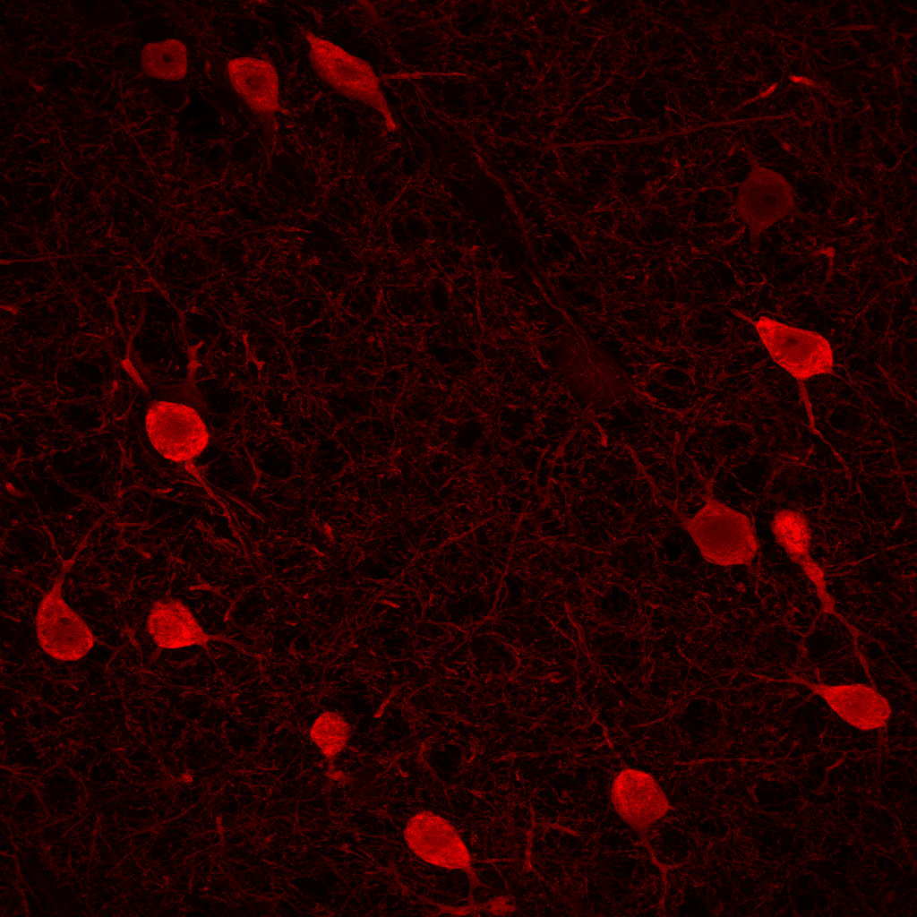
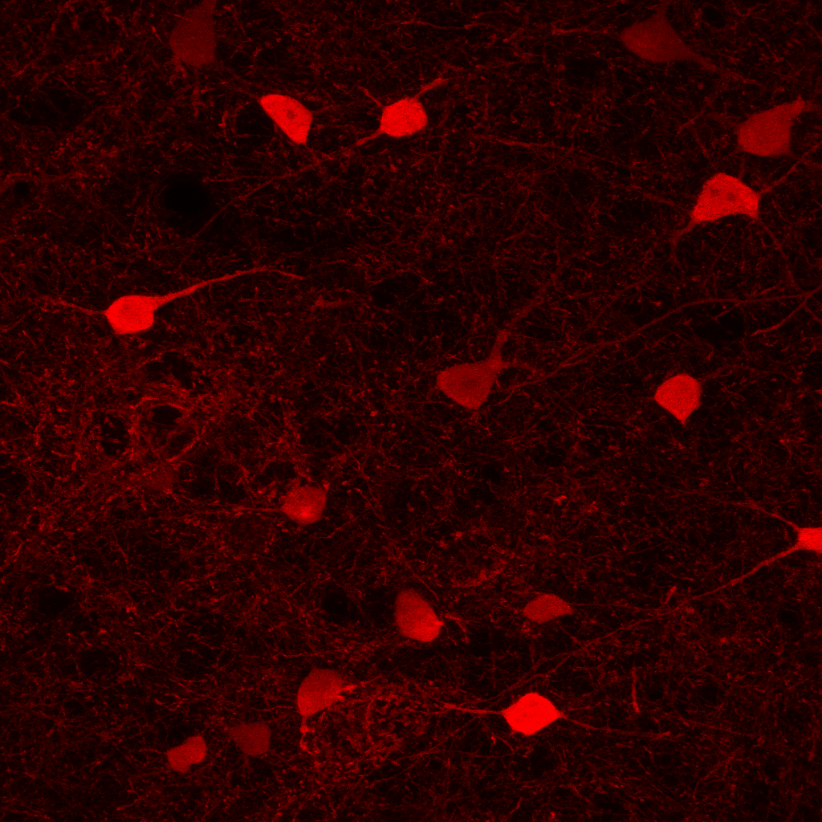
Dnmt 3a^{f/f}
Dnmt 3a^{f/wt}
(anti-PV)

Slide 29
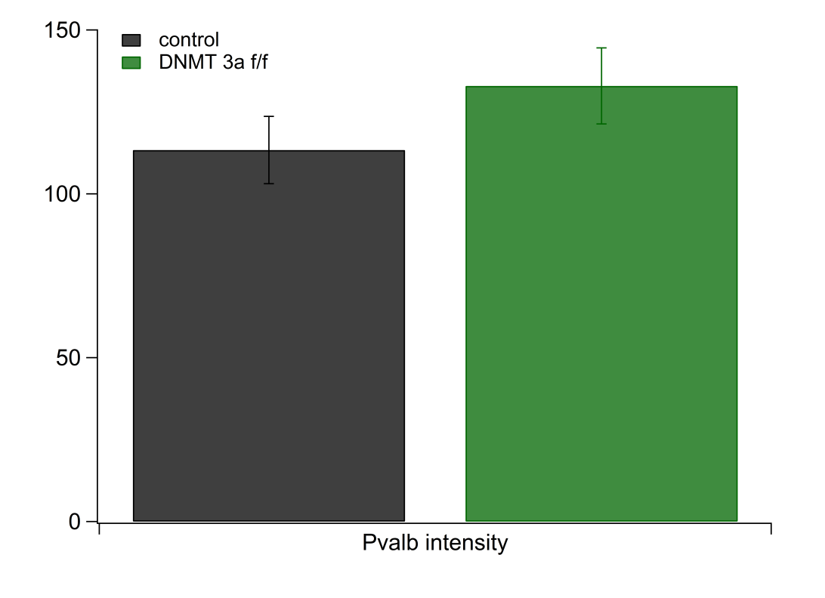

Slide 31
targets?
Dnmt 1
Dnmt 3a
2x-HET
(no effect)
vs.
(effect)
site A
site B

Slide 32
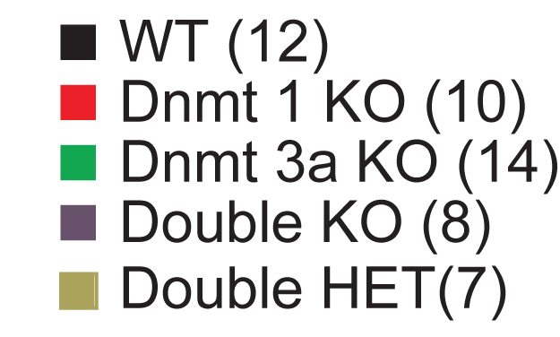
2x-HET and 2x-KO

Slide 33
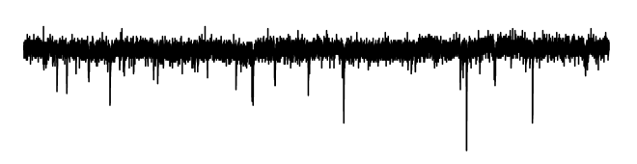

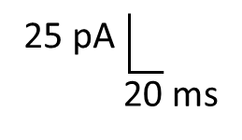
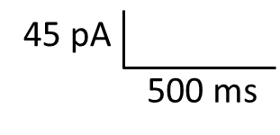
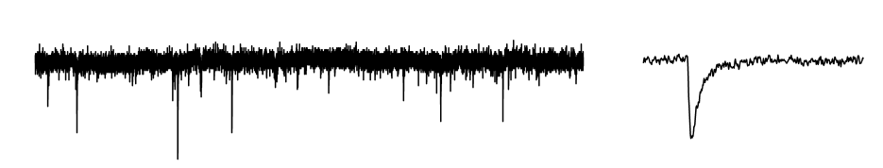
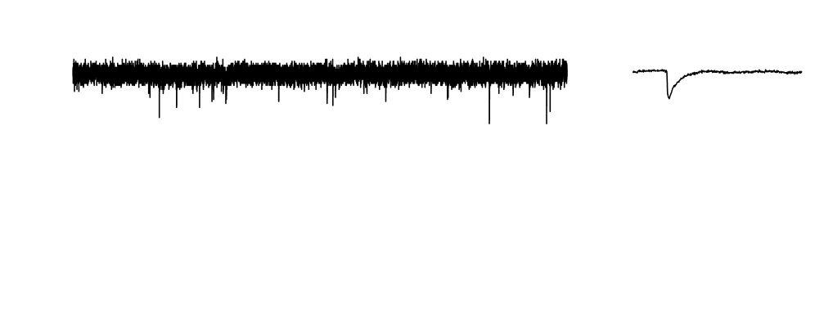
2x-HET and 2x-KO
WT
2-HET
2x-KO
(s)

Slide 34
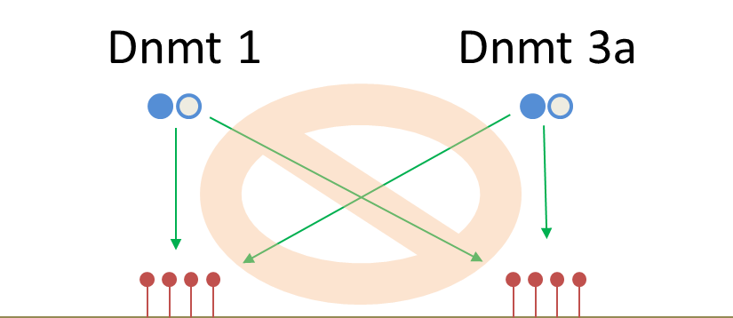
other possibility: de-novo vs. maintenance methylation

Slide 35
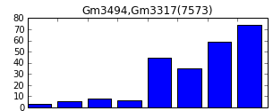
FPKM*
WT
Dnmt 1+3 KO
Dnmt 1 KO
Dnmt 3a HET
(Yasuyuki Shima,
Alexander Christopharo)
*fragments per kilobase of exon per million fragments mapped

Slide 36
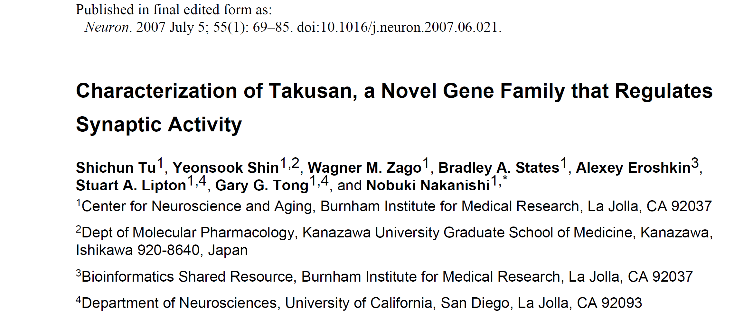
NCBI gene match: takusan* gene family
* “many genes”

Slide 37
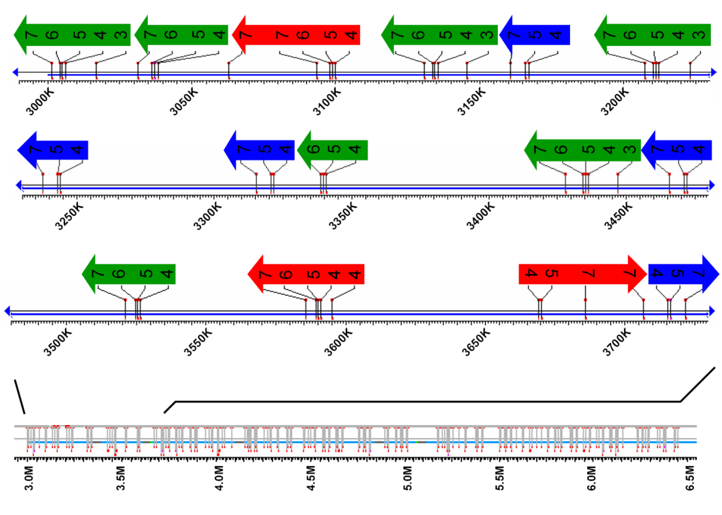
takusan gene family
ch. 14
(Tu et al., 2007)

Slide 38
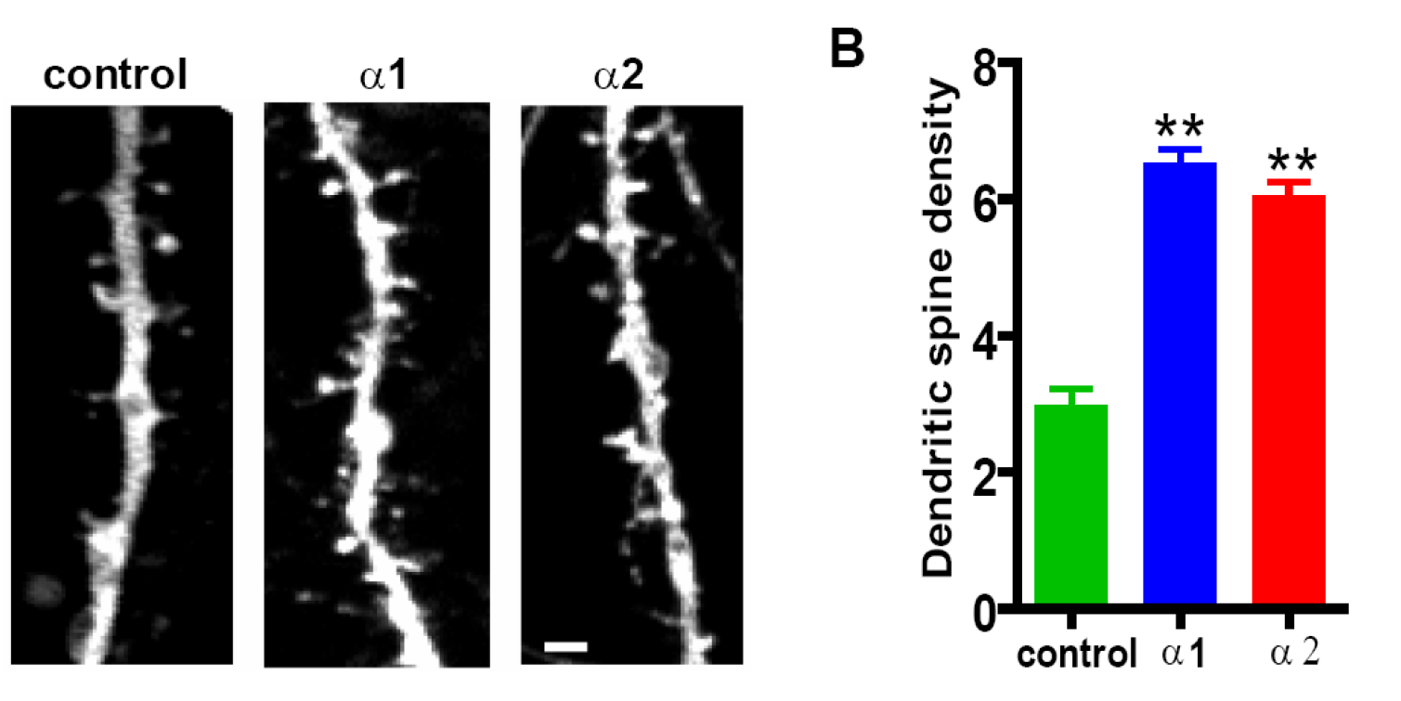
over-expression of takusan:
(Tu et al., 2007)

Slide 39
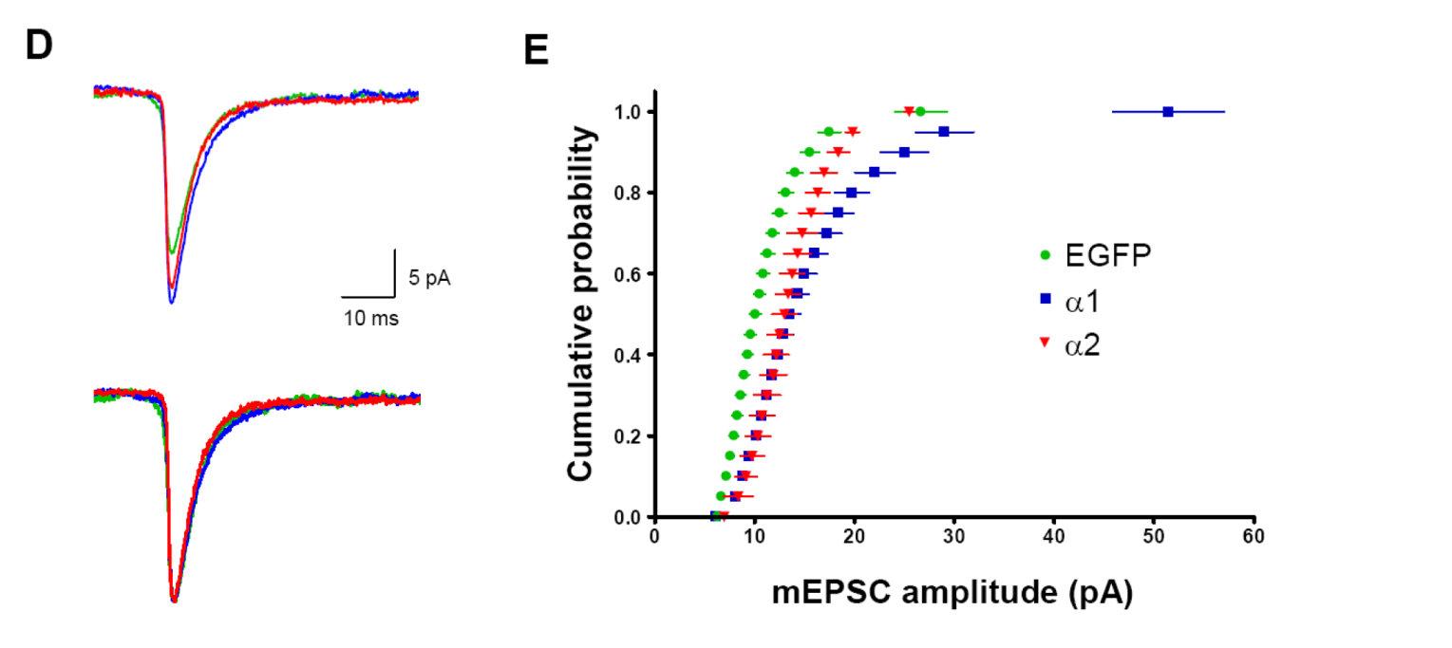
over-expression of takusan:
abs.
norm.
(Tu et al., 2007)

Slide 40
summary
Dnmt 1 and 3a in FS-PV interneurons:
important for maintenance/maturation of “passive”, but not “active”, intrinsic properties
important for maintenance of excitatory, but not inhibitory, synaptic input
haplo-sufficient
likely to have different targets of methylation
~ potential methylation target of interest: takusan gene family

Slide 41
Brief background
DNMT data
NRG-1 project (preliminary data)
Mecp2 project
Summary

Slide 42
excitatory input: mEPSCs
P15
P30
P15
P30

Slide 43
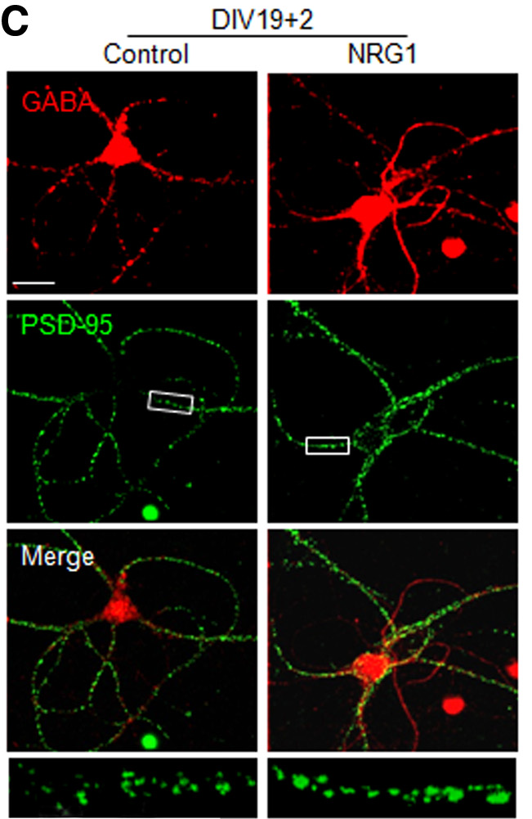

(Ting et al., 2011)

Slide 44

con
NRG-1
slice culture
NRG: DIV 10-15
(equiv. p20-p25)
5 nM
mEPSC amplitude
mEPSC frequency

Slide 45



(Li et al., 2011)

Slide 46
DNMT → ErbB4?

Slide 47


WT
reg ACSF
–70 mV
10 nM NRG-1

Slide 48

WT
reg ACSF
–70 mV
10 nM NRG-1

Slide 49
WT
reg ACSF
–70 mV
10 nM NRG-1
(Li et al., 2011)

Slide 50

WT
reg ACSF
*
–70 mV
***
**
10 nM NRG-1
* fAHP
** mAHP
*** sAHP

Slide 51

SI, layer 2/3
note: chandelier cells are mostly absent in layer 5
(Povysheva et al., 2013)

Slide 52

SI, layer 2/3
(Li et al., 2011)

Slide 53



≈ E_{K+}
(Teshima et al., 2003)

Slide 54

WT
–30
reg ACSF
–70 mV
–70 mV
10 nM NRG-1

Slide 55


DNMT dKO
reg ACSF
–70 mV
10 nM NRG-1

Slide 56


Slide 57
Brief background
DNMT data
NRG-1 project
Mecp2 project
Summary

Slide 58

in pyr. neurons:
(Feng and Nestler, 2010)
Rett Syndrome:
caused by mutation of Mecp2 in 90% cases
lethal in boys (X-linked)
leads to severe neurological abnormalities and developmental delay/arrest in girls
symptoms mimicked by mouse models with Mecp2 KO
Mecp2 KO leads to disbalance of excitation and inhibition
(Dani et al., 2005)

Slide 59


P30
WT
Y/X^{Mecp2 KO} + PV-T2A-Cre + H2B-GFP
vs.
Y/X^{wt} + …
Mecp2 KO
wt
dKO
DNMT wt
DNMT dKO

Slide 60

P30
WT
Y/X^{Mecp2 KO} + PV-T2A-Cre + H2B-GFP
vs.
Y/X^{wt} + …
Mecp2 KO
wt
dKO
DNMT wt
DNMT dKO

Slide 61
DNMT 1/3a vs. Mecp2 KOs:
other readouts of methylation in PV-FS interneurons besides Mecp2
different developmental time points of KO
conditional vs. global KO

Slide 62


P15

Slide 63
DNMT 1/3a vs. Mecp2 KOs:
other readouts of methylation in PV-FS interneurons besides Mecp2
different developmental time points of KO
conditional vs. global KO

Slide 64
summary
Dnmt 1 and 3a in FS-PV interneurons:
important for maintenance/maturation of passive, but not active, intrinsic properties
important for maintenance of excitatory, but not inhibitory, synaptic input
haplo-sufficient
possible target: takusan gene family
Mecp2 KO in FS-PV interneurons:
results in abnormal increase in frequency of mEPSCs at P25–30, but not P15
results in increased excitability (measured by Rin)
~ NRG increases excitability and abolishes I_{AHP} in WT, but not DNMT KO neurons

Slide 65
Ongoing experiments:
slice culture: long-term effects of NRG1
EEG: gamma rhythms
seizure threshold
RNAseq (Yasuyuki Shima, Alexander Cristofaro)
filling RoR-β KO neurons

Slide 66


motor cortex
sensory cortex
WT DNMT1/3a 2x-KO
WT DNMT1/3a 2x-KO
in collab. with Praveen Taneja

Slide 67

Acknowledgements
Sacha Nelson
Praveen Taneja
Mark Miller
Sean O’Toole
Yasmin Escobedo-Lozoya
Lorraine Lei
Tim Lauer
Zhe Ming
Yasu Shima
Alexander Cristofaro
Ken Sugino
Josh Huang Lab (CSH)
UCLA Whitehead Institute Supported by NINDS

Slide 68
Thank you for your attention!

Slide 69
2P uncaging application
replacing paired recordings:
Inputs to L5 PV+ cells?
Strength of PV+ output to pyramidal neurons
Pyramidal input to PV+ interneurons: paired-pulse ratio; change in connection probability
more fun stuff:
dendritic integration in PV+ interneurons in DNMT and Mecp2 KOs
effects on changes in perisomatic output (if any) on pyramidal dendritic integration

